Slide 1


Seminar4 Topic2
Full-bridge rectifier & Full-wave inverter
Reporter：DingYibo NIEYongxin WUDi
Group7
Nov.23 2020

Slide 2
Work Division
Ding Yibo:
Powerpoint , Simulation, Discussion
Wu Di:
Simuation, Discussion
Yuan Shuangyue:
Simulation , Discussion
0

Slide 3


Simulation Model
& Parameter Setup
01
Task 1
Operating principle & sequence
02
Task 2
Analysis about CCM & DCM
03
Task 3
Relationships between D and G
04
1

Slide 4
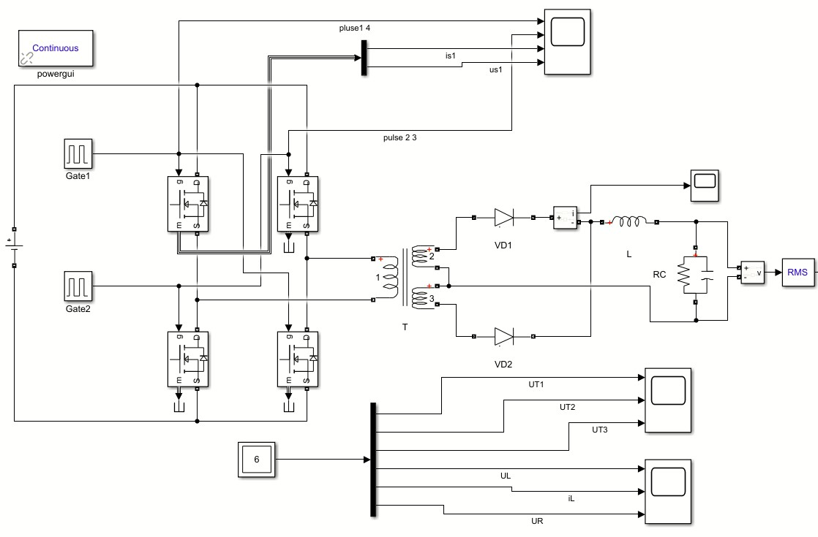
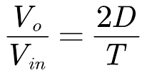
Part1 Simulation Model & Parameter Setup
Table 1. The Given Parameters for Topic2
R_{L} | f_{s} | L | C
10Ω | 100kHz | 300uH | 200uF
V_{in} | V_{o} | T
600V | 48V | 4:1:1
Duty Ratio
D=0.16
Fig.1 Simulink model for topic2
2

Slide 5
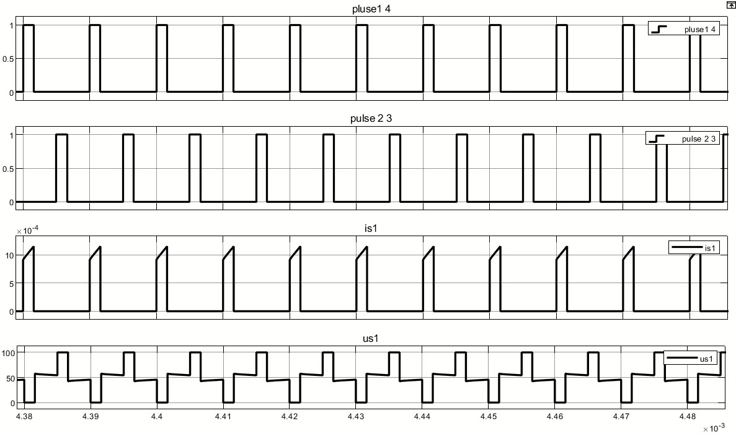
Part2: Task 1
Operating principle & sequence
(1) Full-bridge inverter
D=0.16
Two groups of MOSFETs conducts complementarily
Fig.2 Waveforms of pulse signal and MOSFET
2

Slide 6
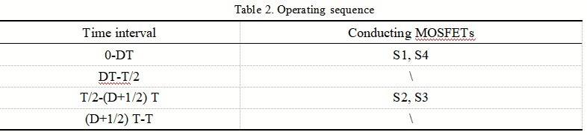
Part2: Task 1
Operating principle & sequence
Therefore, we could have the operating sequence:
2

Slide 7
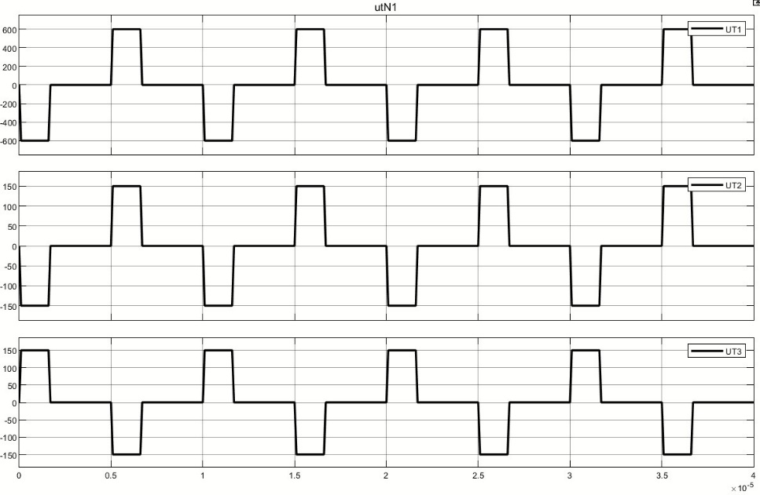
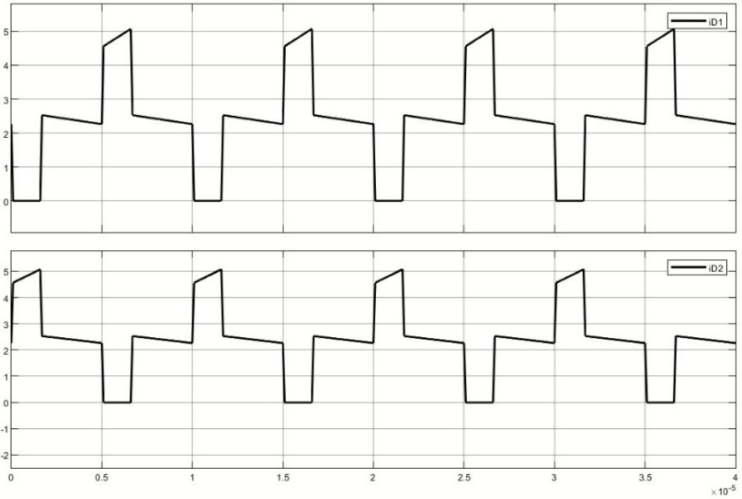
Part2: Task 1
Operating principle & sequence
(2) Full-wave rectifier
Fig. 3 Voltage waveforms of transformer
Fig. 4 Current waveform of diodes
4:1:1
2

Slide 8
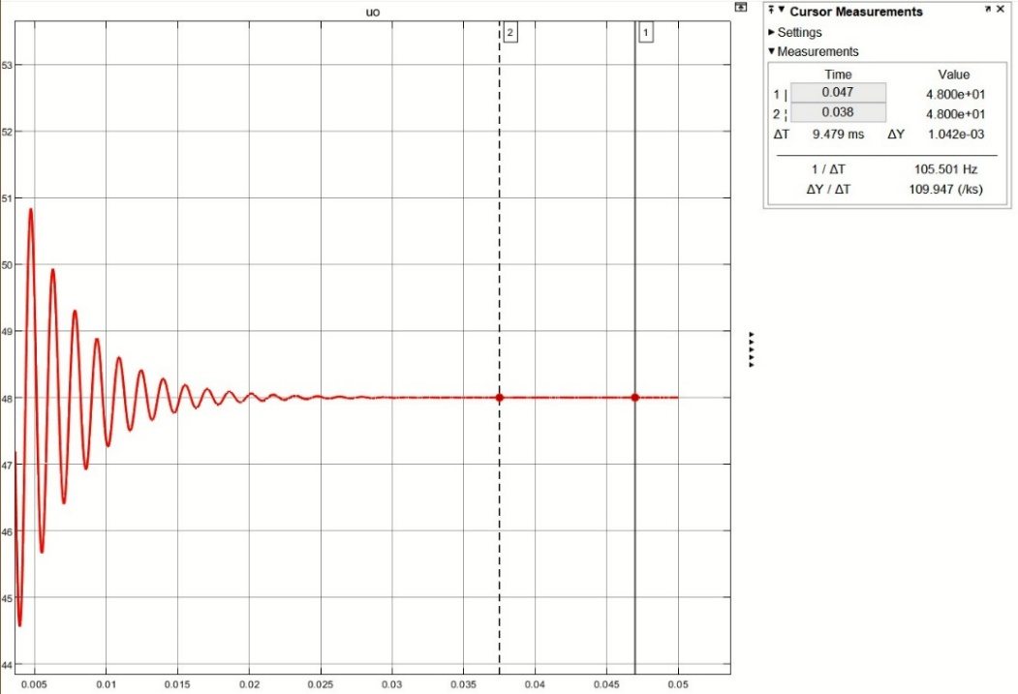
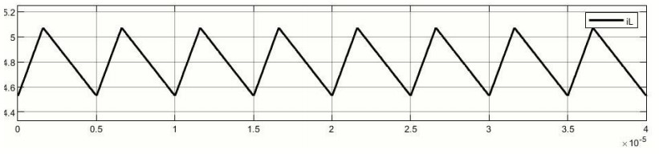
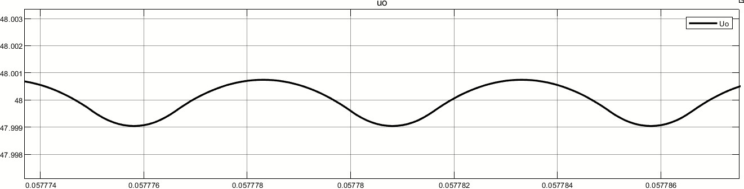
Part2: Task 1
Operating principle & sequence
Fig. 6 Waveform of inductor current
Fig. 7 Detailed waveform of output voltage
Fig. 5 Waveform of output voltage
2

Slide 9
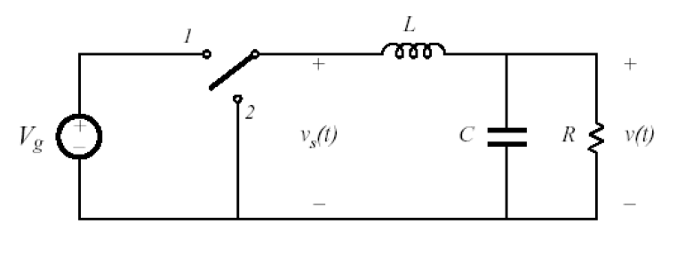
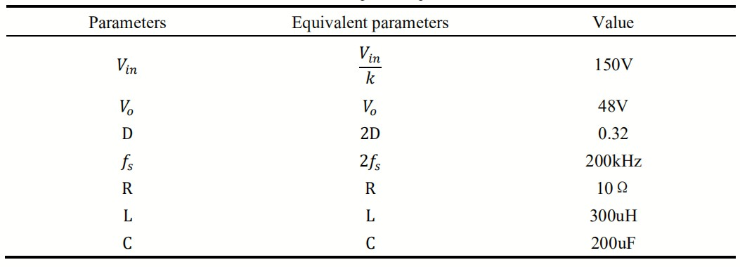
Part3: Task 2
Analysis about CCM & DCM
(1)Calculation of critical resistance
Tab.3 Equivalent parameters
Fig. 8 Equivalent buck converter
First, we could have the equivalent buck converter.
2

Slide 10
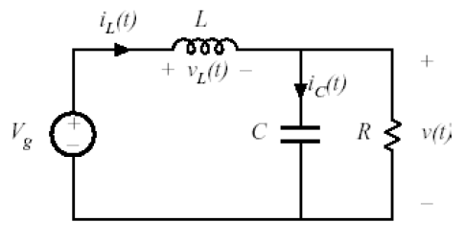
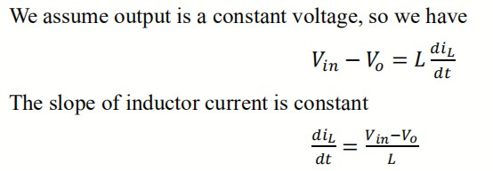
Part3: Task 2
Analysis about CCM & DCM
(1)Calculation of critical resistance
Fig. 9 On-state buck converter
Next, we analyze the on-state.
2

Slide 11
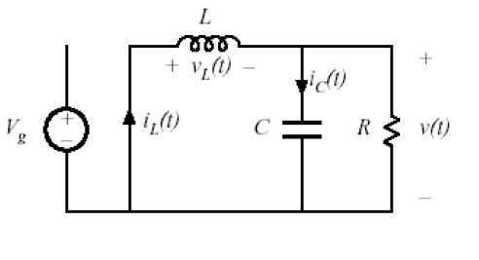
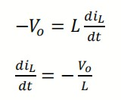
Part3: Task 2
Analysis about CCM & DCM
(1)Calculation of critical resistance
Similarly, we have
Fig. 10 Off-stste buck converter
Afterwards, we analyze the off-state.
2

Slide 12
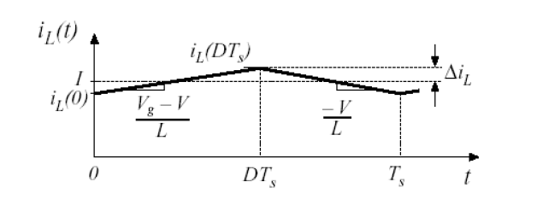

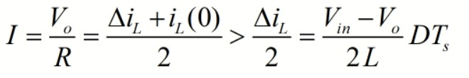
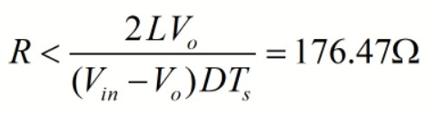
Part3: Task 2
Analysis about CCM & DCM
(1)Calculation of critical resistance
When the resistor is at its critical value
To make the current continuous, we have
Therefore, we have
Fig. 11 Waveform of inductor current
2

Slide 13
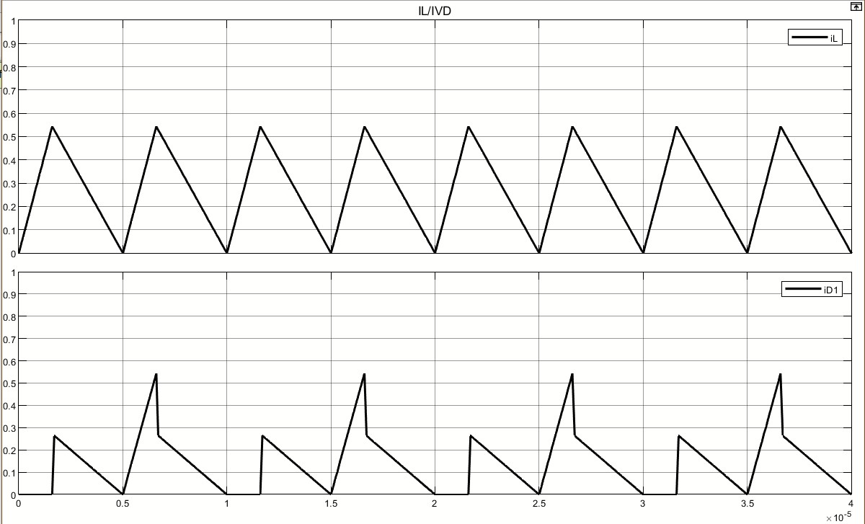

Part3: Task 2
Analysis about CCM & DCM
(2)Waveforms under different resistance
Fig. 11 Critical mode current
2

Slide 14
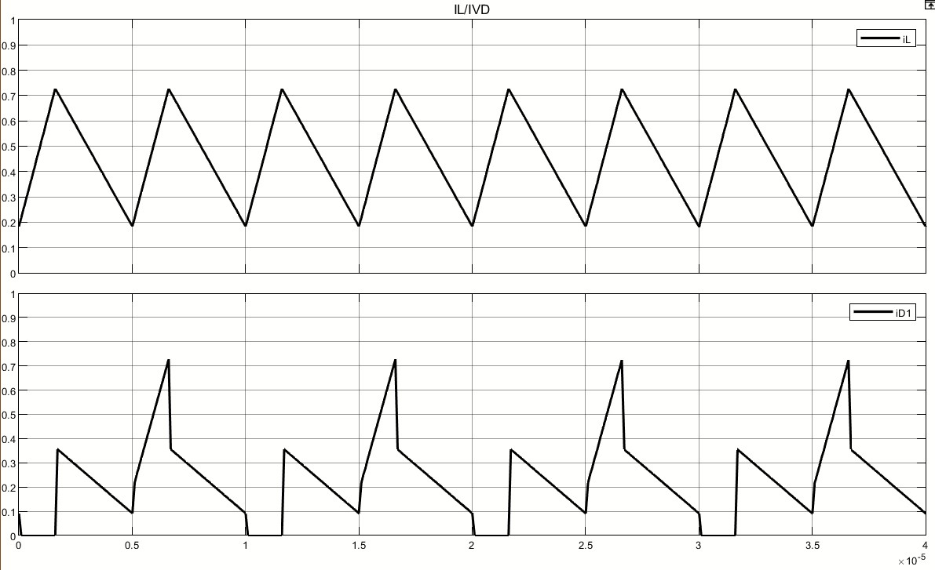

Part3: Task 2
Analysis about CCM & DCM
(2)Waveforms under different resistance
Fig. 12 CCM mode current
2

Slide 15
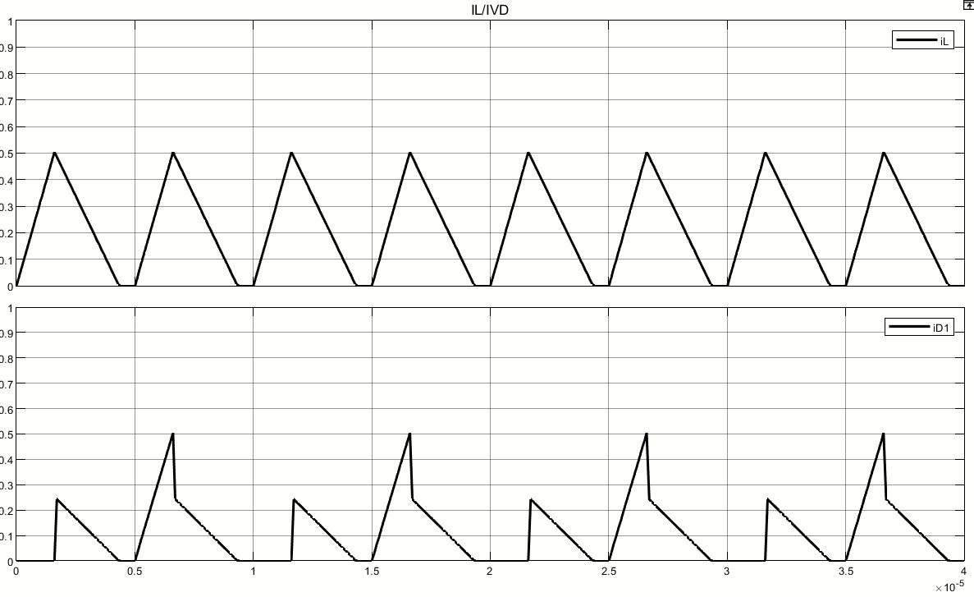

Part3: Task 2
Analysis about CCM & DCM
(2)Waveforms under different resistance
Fig. 13 DCM mode current
2

Slide 16
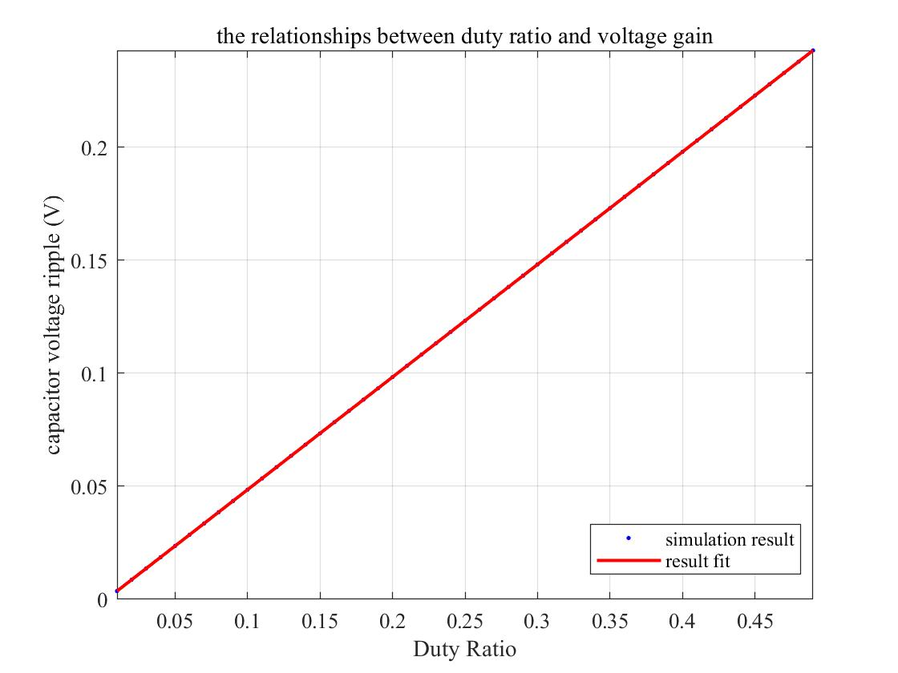
Part4: Task 3
Relationships between D and G
Based on the defintition of voltage gain, we have
The slope of the curve should be 0.5
Fig. 14 DCM mode current
2

Slide 17
# Input/output Voltage Relationships
2

